Slide 1
Name: Circular Pie
Type: Application Architecture
View: Logical View
Style: Layered Architecture Pattern
Users
Delivery Channels
Core Business Process
Data and Information
Technology Enablers
Browser Website
Customize product
Food Information
Database Connector
Customers
Order Pizzas
Payment gateway API
User Information
Deliver pizzas
User Interface
Payment Information
Advertisers
Payment
Application Hosting Service
Contact Support
Advertising Data
Version Control and Delivery Pipeline
Advertise

Slide 2
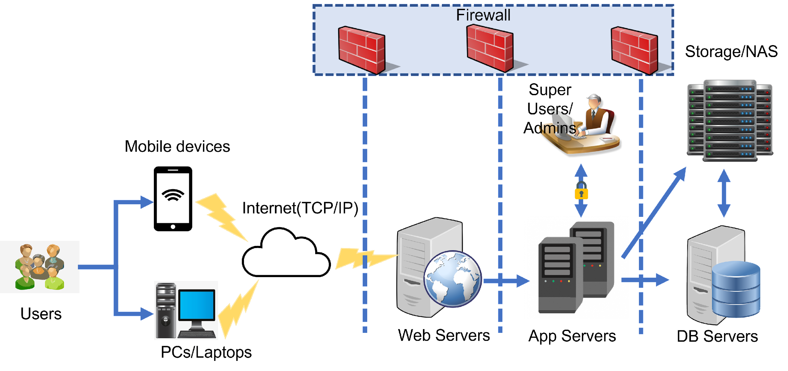
Application: Circular Pie
Type: Application Architecture
View: Process View
Style: Layered Architecture Pattern

Slide 3



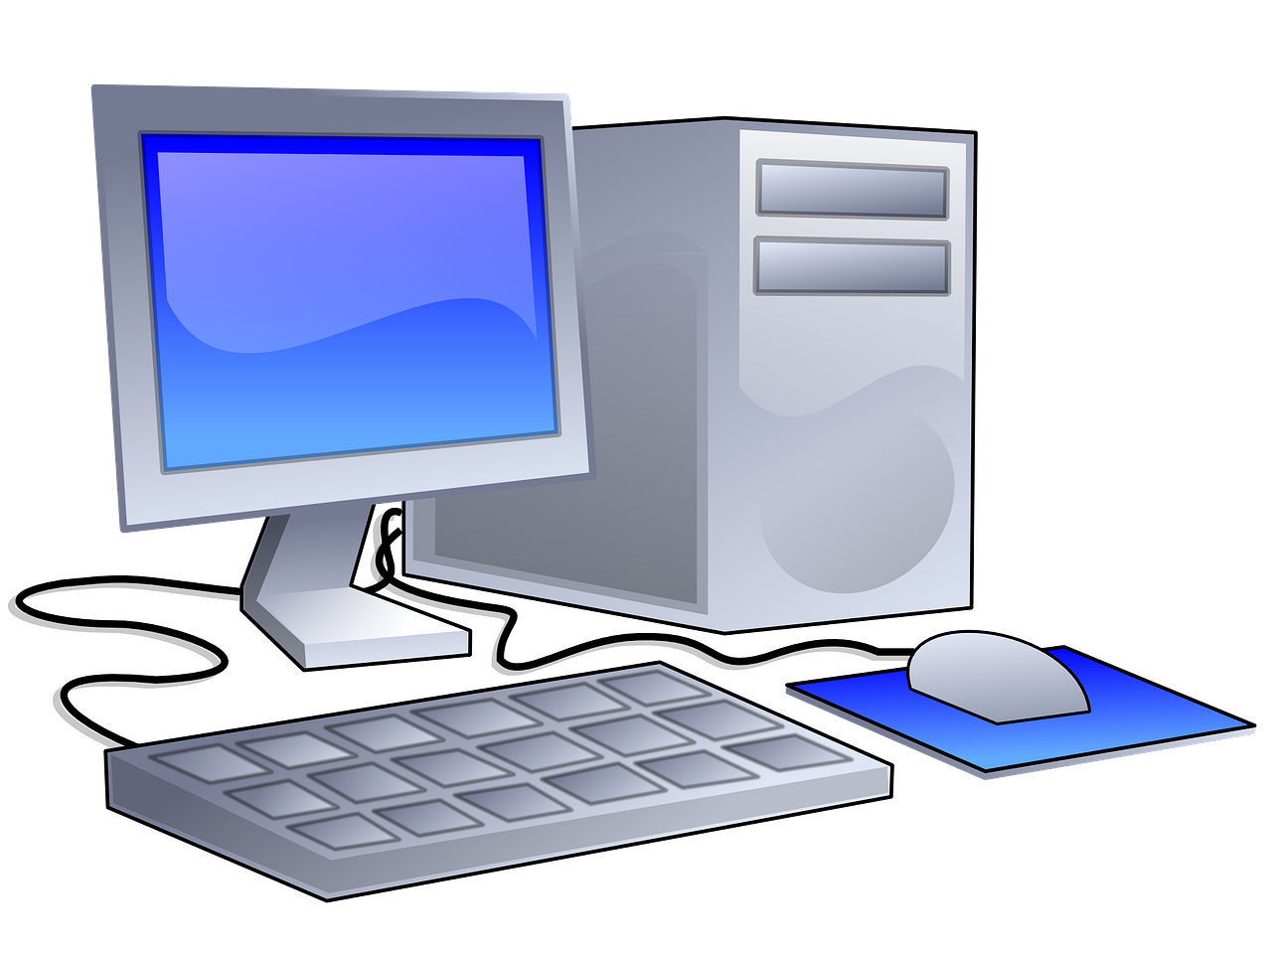

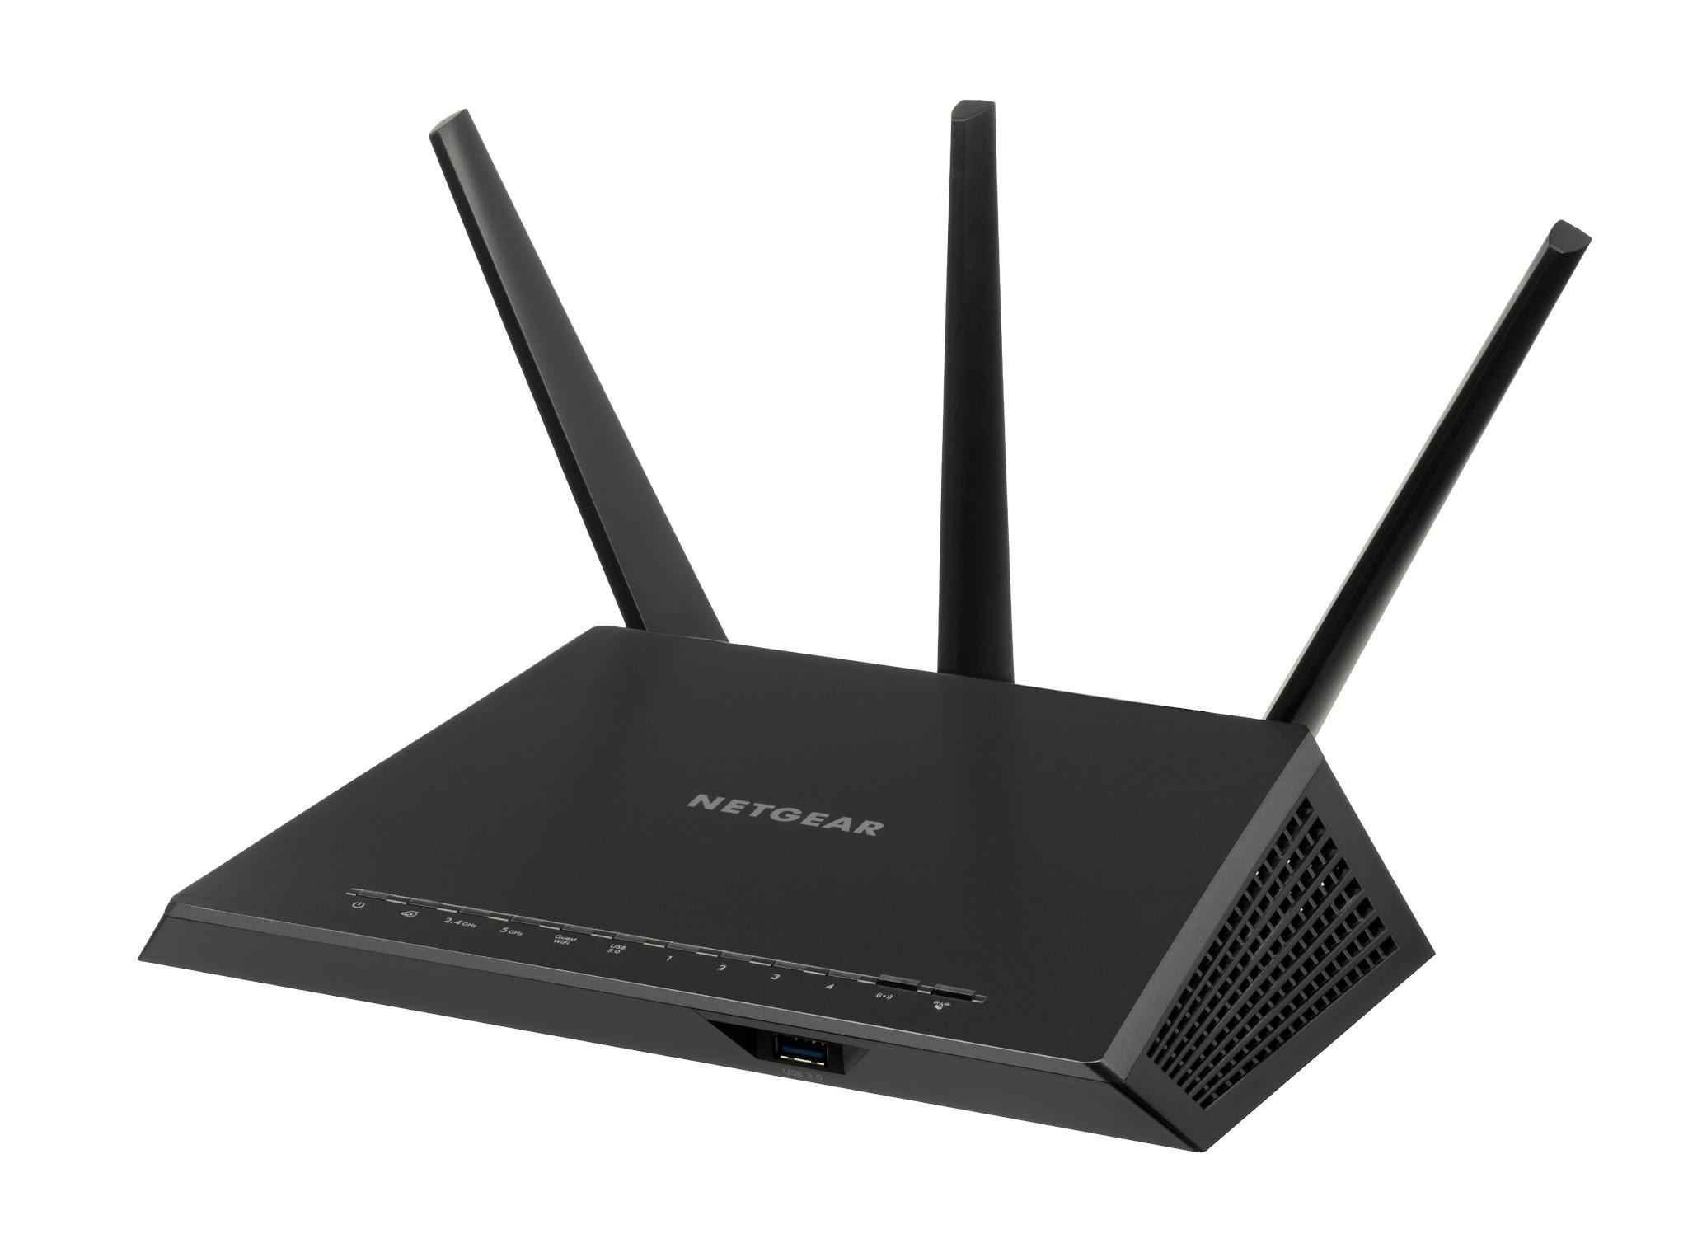
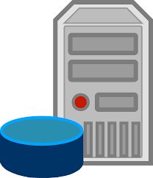


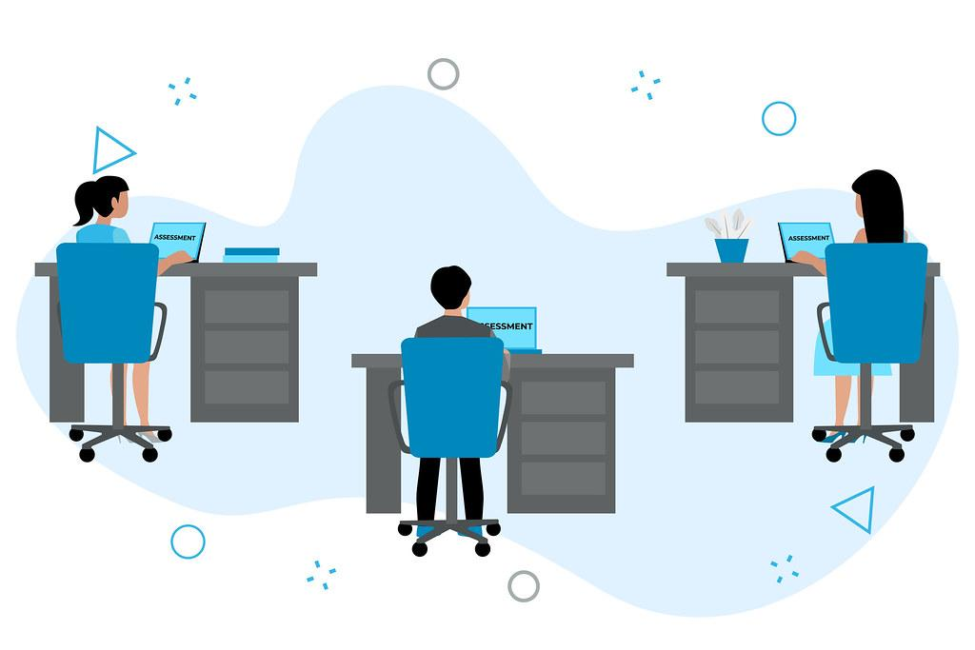
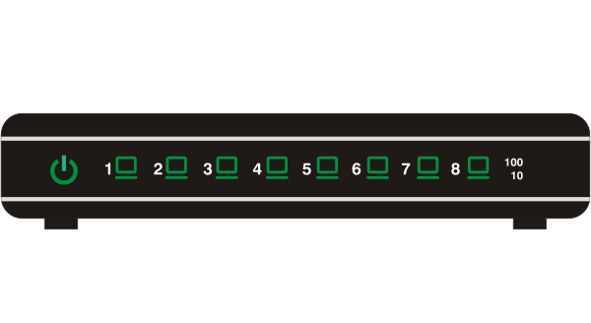
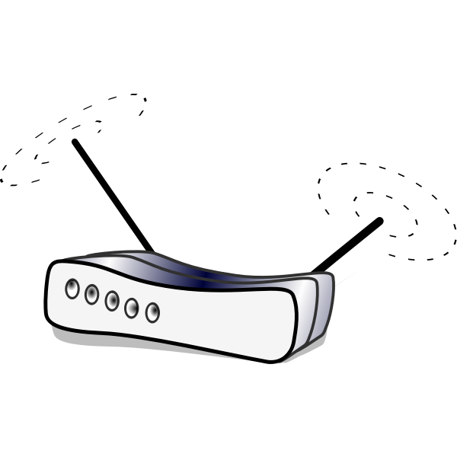

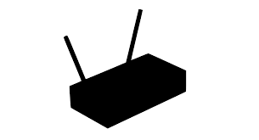


Application: Circular Pie
Type: Application Architecture
View: Physical View
Style: Layered Architecture Pattern
Internal Layer
Internet
Web Application Layer
Admin
Cisco ASA Firewall
Cisco Router
Web Application Server
External Layer
Firewall
Cisco ASA Firewall
Workstation
Cisco Catalyst Switch
Communication IBM Server
DB Server
Router
Employee
Office Equipments
Wireless Access Point WiFi
PC
User
PC

